Slide 1
A Fuzzy based data perturbation technique for privacy preserving data mining

Slide 2
introduction
Privacy preservation is the major concern while real time datasets are handled.
Privacy preserving data mining (PPDM), deals with data modification and also limits information loss.
Data perturbation is one of the PPDM techniques which deals with numerical data and focuses on maintaining statistical properties of data.
There are two types of perturbation, additive perturbation and multiplicative perturbation, where generated random value is either added or multiplied to the data, which results in a modified data.

Slide 3
Problem description
Privacy preservation is the major concern while real time datasets are handled.
In the online environment, where vast amounts of personal data are shared and transferred around the globe instantaneously, it is increasingly difficult for people to maintain control of their personal information. This is where data protection comes in.

Slide 4
AIM
To provide protection of the data with different levels of privacy based on the roles of the candidates in a banking institution. As every member has to have access to specific entities for important business analysis and strategy application, fuzzy logic has been considered as an attractive method for data distortion which can condense the information loss.

Slide 5
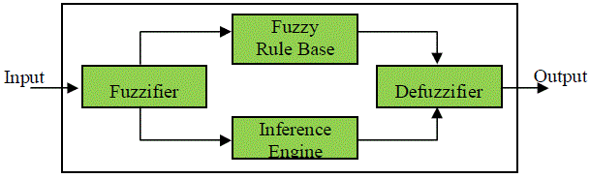
Proposed method
The role of Fuzzifier is to convert a crisp input variable into linguistic variables that is ready to be processed by the inference engine.
The Inference Engine using the fuzzified inputs and the rules stored in the rule base, processes the incoming data and produces linguistic output.
Once the output linguistic values are available, the Defuzzifier produces the final crisp values from the output linguistic value.

Slide 6
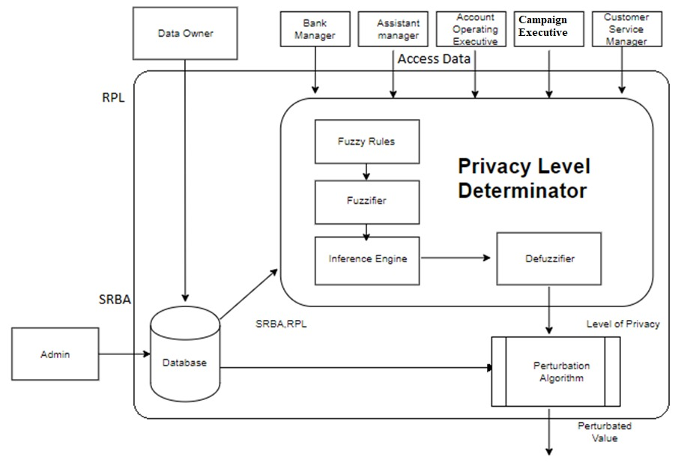
CHOSEN SYSTEM ARCHITECTURE

Slide 7
IMPLEMENTATION
The dataset is preloaded into the local database. The software into which the user has to login, has the SRBA value that is used to indicate if the party has to be given the access or not and also RPL value that is required privacy level are predefined by the owner.
These values are passed into the triangular membership function of the fuzzification module. In this function, the attribute values are mapped to a value between ‘zero’ and ‘one’ which is the degree of membership.
The crisp output values are then interpreted into a linguistic value of membership.

Slide 8
These linguistic values of membership are then sent into the inference engine with the predefined fuzzy rules and processed to get LoP (Level of privacy) in linguistic format.
The LoP is then converted into crisp value in the de-fuzzification module. This value of LoP is passed into the function that gives a random value as output. This random value is then passed into the perturbation function that adds the required data with value.

Slide 9
Fuzzy rule base
If (RPL is High) and (SRBA is NotAllow) then (LoP is High)
If (RPL is medium) then (LoP is medium)
If (RPL is Low) and (SRBA is Allow) then (LoP is Low)

Slide 10
OBJECTS AND LIBRARIES
Objects and packages used in the proposed system are,
NumPy
SkFuzzy
PyMySql
Matplotlib

Slide 11
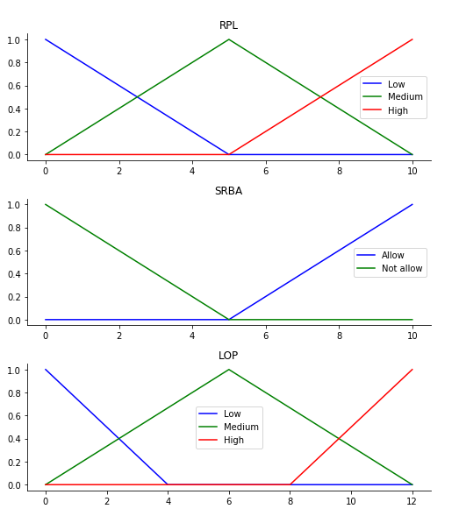
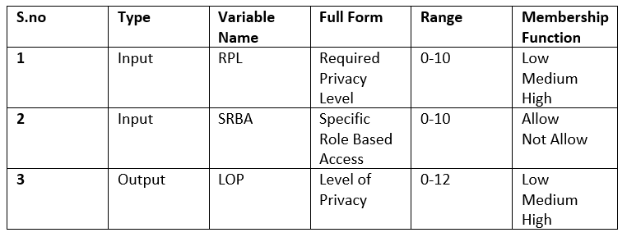
Membership Function

Slide 12
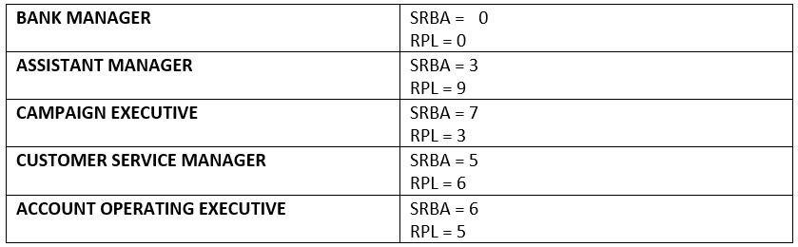
SRBA AND RPL
1

Slide 13
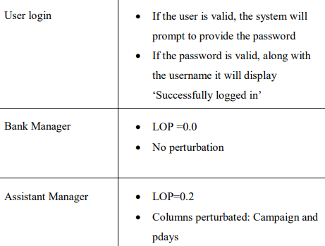
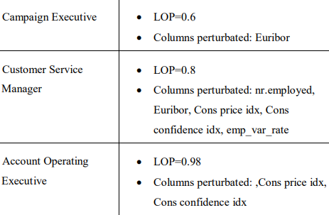

Slide 14
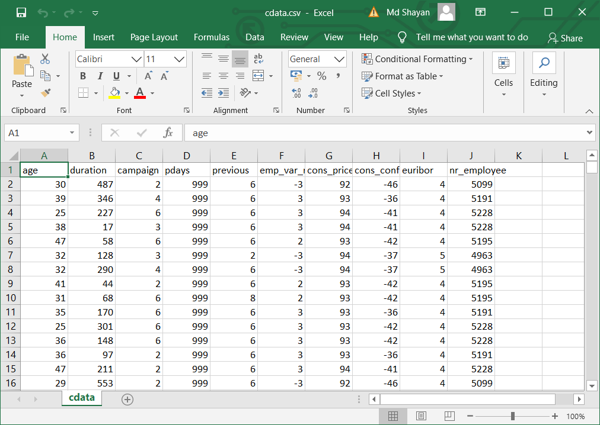
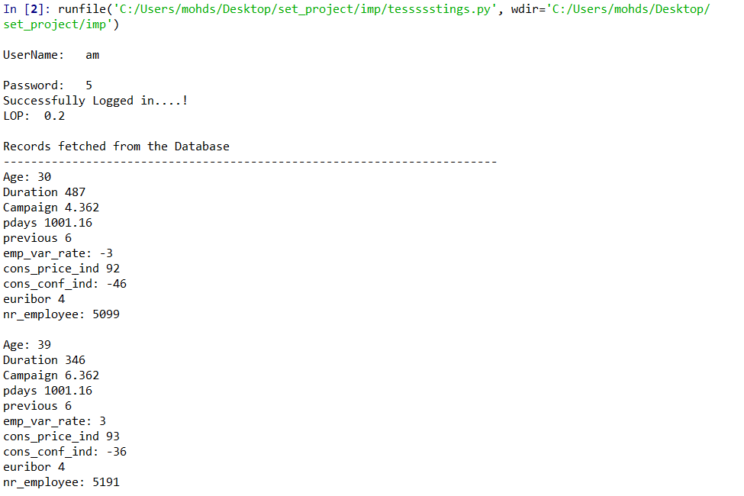
OUTPUT AFTER perturbation

Slide 15
Thank you

